Slide 1

Execution (work Flow)

Slide 2

PART 01
Introduction
PART 4
Market Requirement
CRM
System
PART 02
What is Workflow
PART 5
Designing Software
PART 03
Execution Through
Various Campaign
PART 6
Flow Chart

Slide 3
PART 01
Introduction
Empowering Innovation, One Step at one time

Slide 4
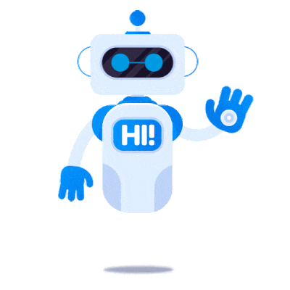
BIGDATA
Introduction:
Focus Areas :
Automating processes
Enhancing productivity
Minimizing manual effort and errors
Objective :
To showcase the seamless workflow execution and benefits of Pabbly's automation capabilities.
Purpose of the Project (UFM) :
Demonstrate how Pabbly can simplify tasks through triggers and actions for efficient automation.

Slide 5
What is workflow
PART 02
How actually does the trigger event works?

Slide 6
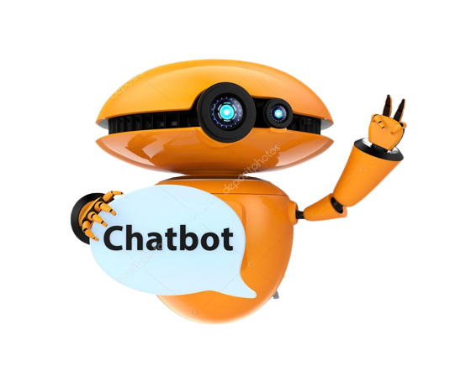
What is Trigger & Action ?
Trigger : The initial event that activates a workflow, such as submitting a form or receiving a payment.
Action : The operation executed in response to the trigger, like sending an email, saving data to a CRM, or updating a spreadsheet.
Automation : Connects triggers and actions seamlessly, automating repetitive tasks to enhance efficiency and reduce errors.

Slide 7
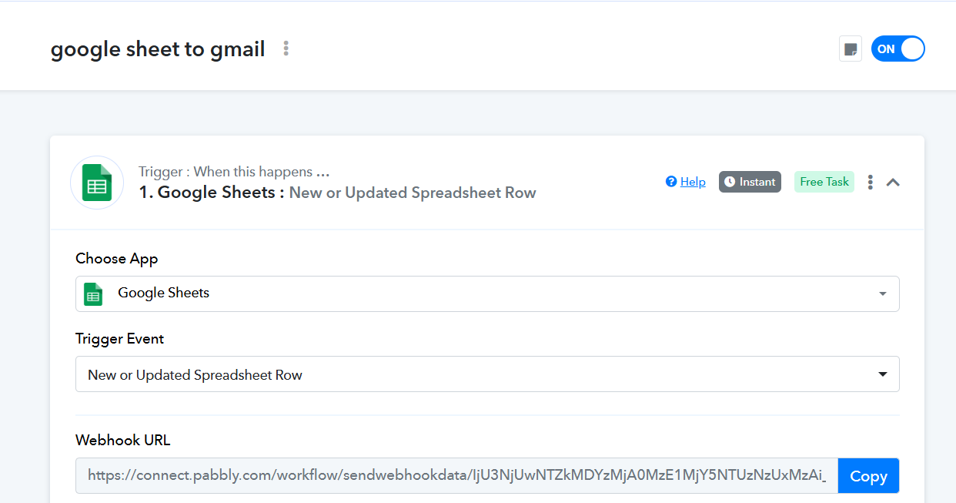
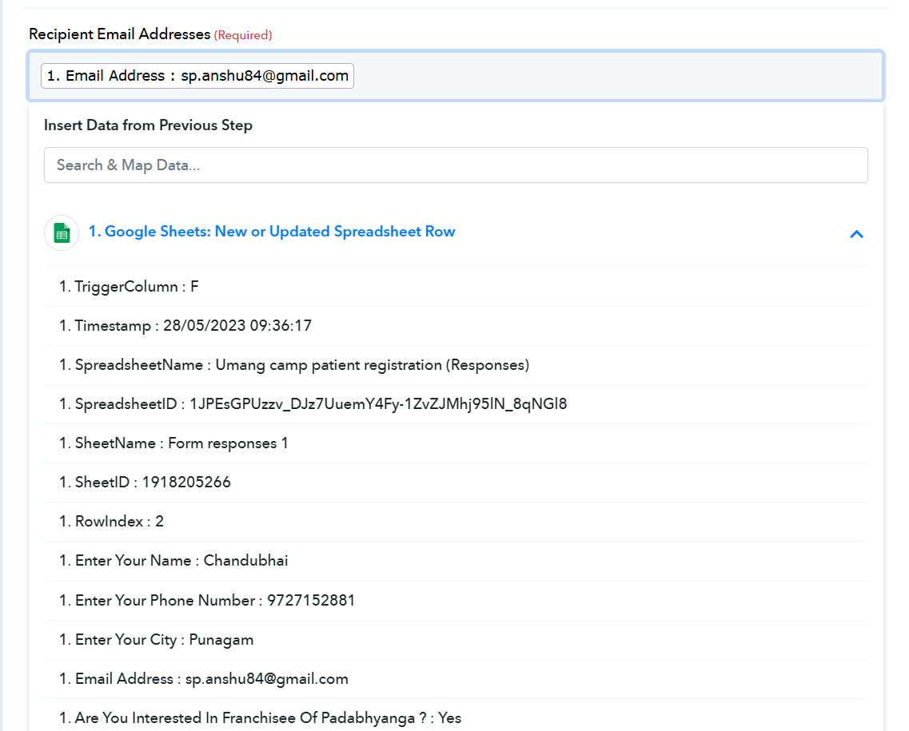

Slide 8
PART 03
Execution Through
Various Campaign

Slide 9
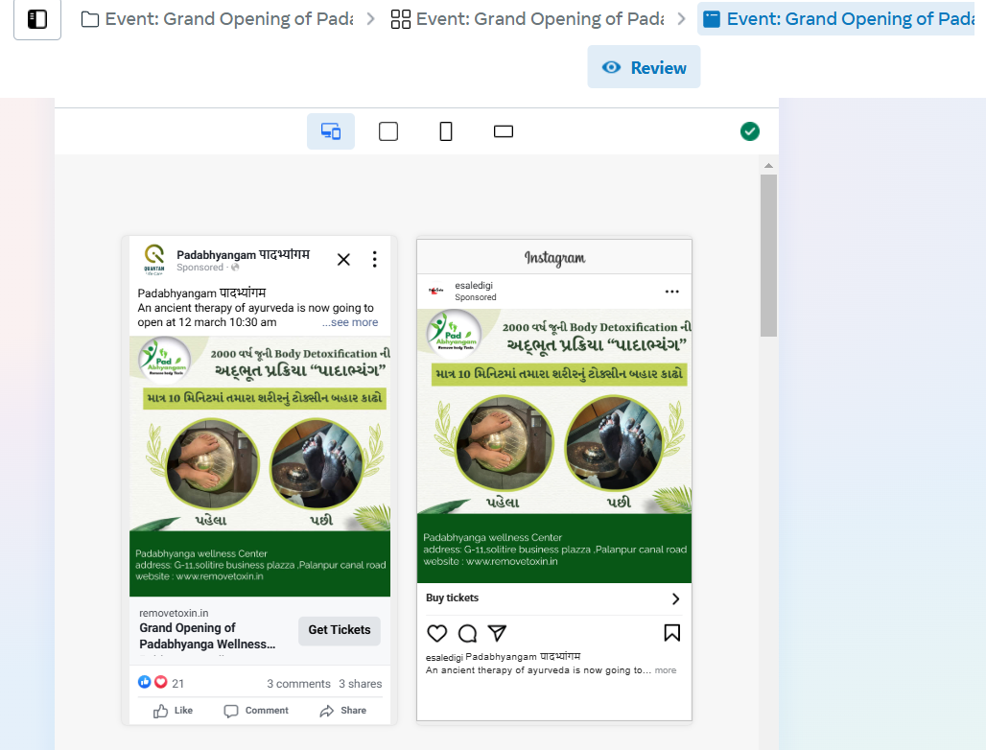

Slide 10
PART 04
Market Requirements Of chatbot
It is also known as Chat Bot marketing.

Slide 11

Chatbot Marketing
Chatbot marketing is a way to promote products and services using a chatbot — a computer application that carries conversations with users by a predetermined scenario or with the help of AI.
Brands create this virtual assistant with a chatbot builder, and connect it with messaging apps like Facebook Messenger, WhatsApp, Snapchat, Telegram, etc., or add it to their website.

Slide 12
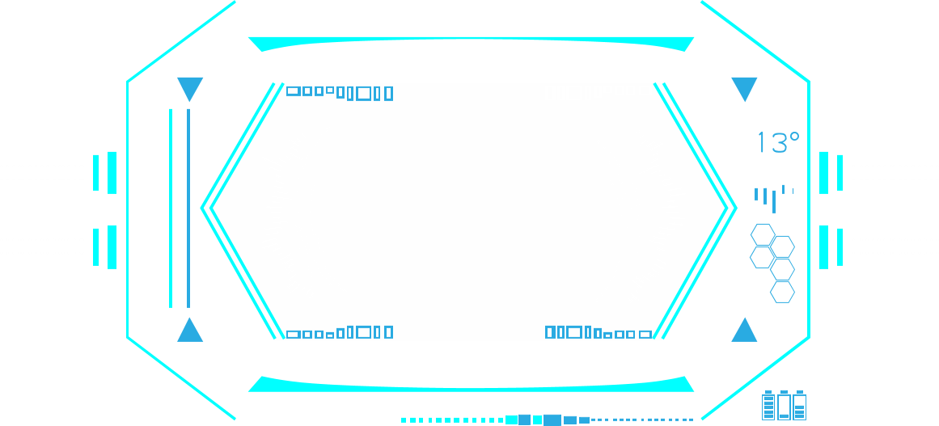
Benefits Of Chatbot Marketing :
Saves times and money
Helps segment traffic
Provide a quick response
Speeds up payment process
Fits any business
Boosts engagement
Gives data for analysis
Helps in lead nurturing

Slide 13
PART 05
Designing Software

Slide 14

Figma
Adobe Photoshop
ChatGPT
Adobe Premier Pro

Slide 15
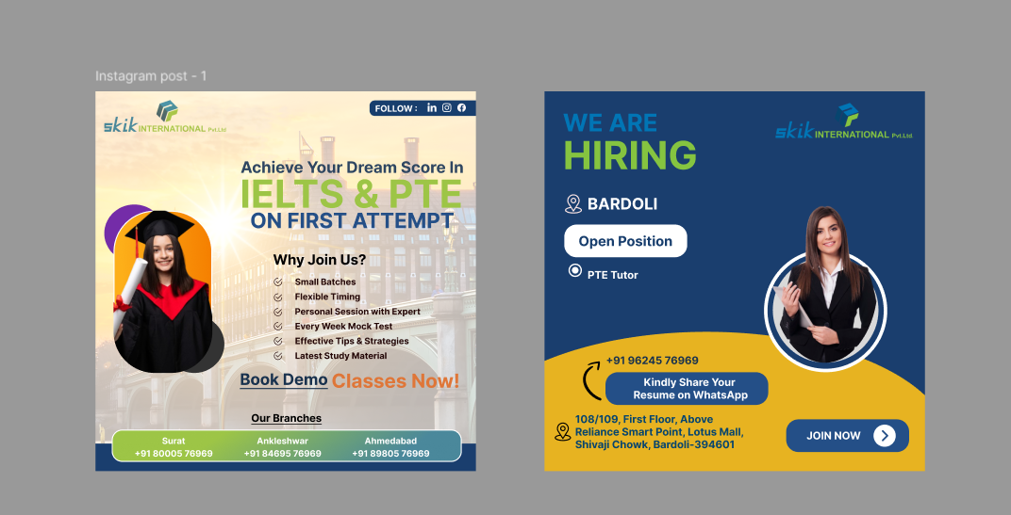

Slide 16
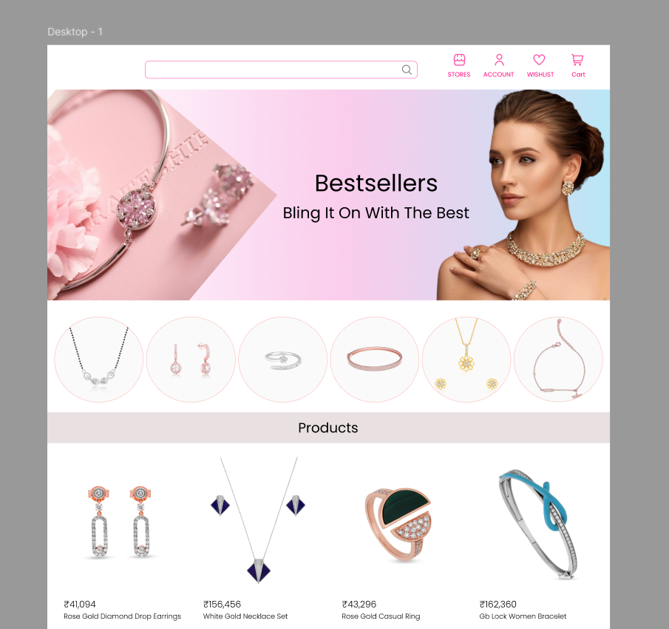
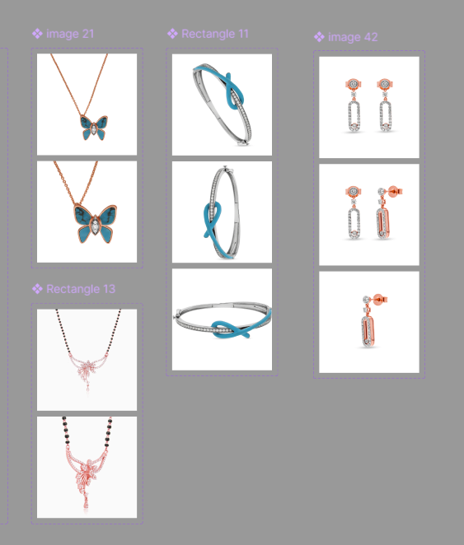

Slide 17
PART 06
Principle Of Chatbot (Using FAQs)

Slide 18
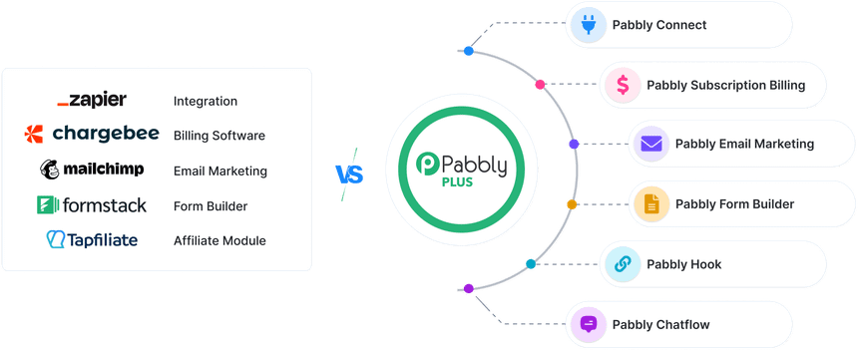
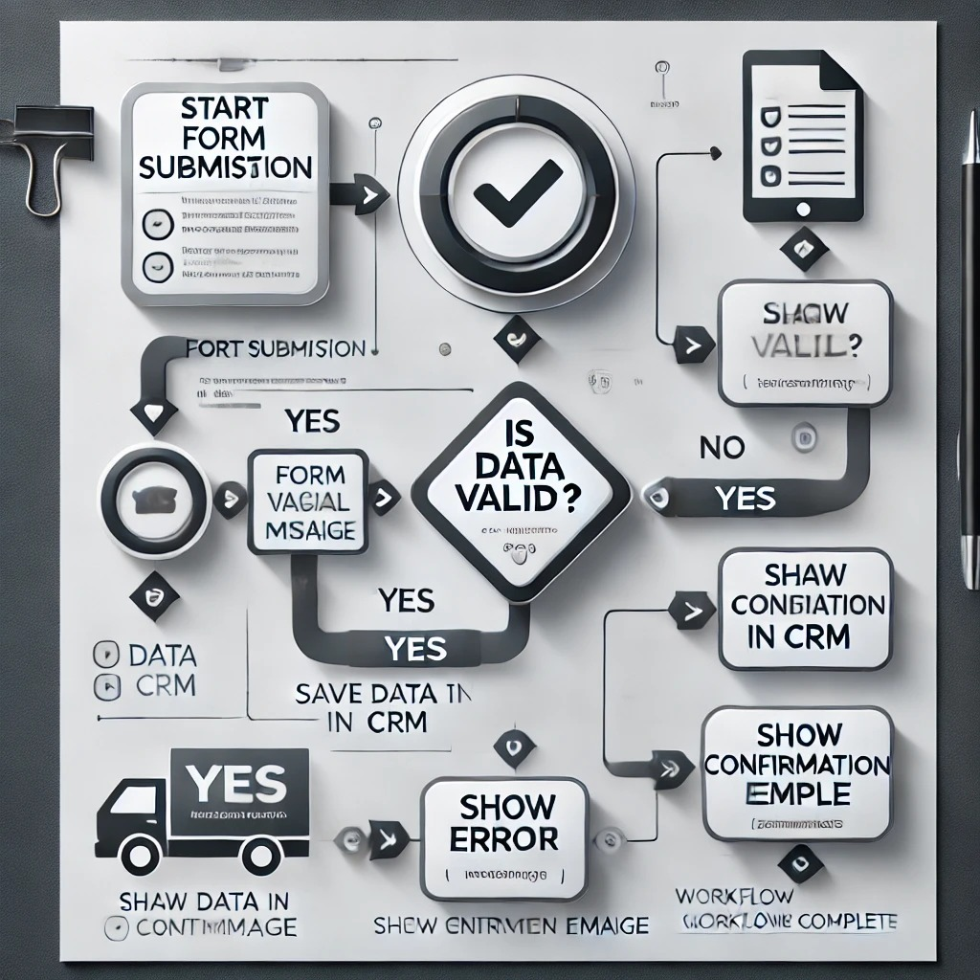

Slide 19
SEO
SEO (Search Engine Optimization)

Slide 20
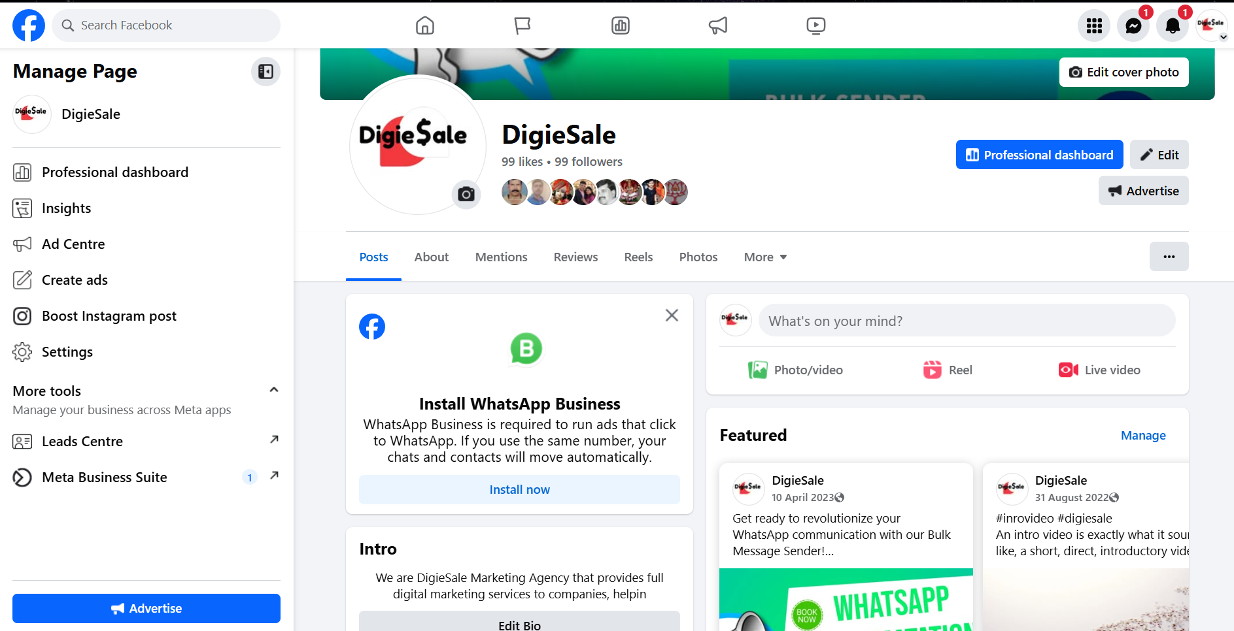

Slide 21
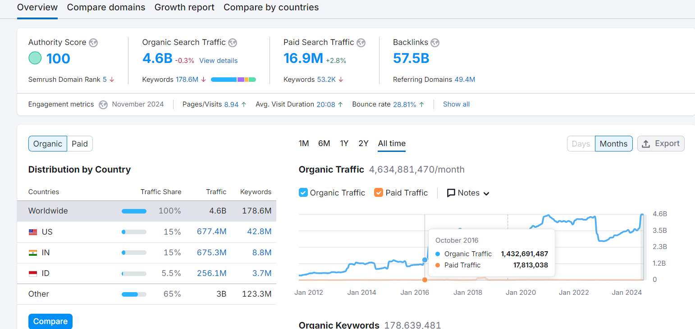

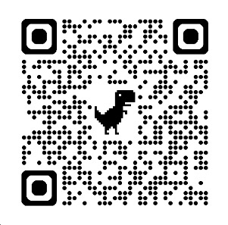
Search Yourself By Keyword: DigiEsale

Slide 22








THANK YOU

